Slide 1
Pelvic Inflammatory Disease (PID)
Dr. Indira Fonseka
Department of Medical Microbiology

Slide 2
Outline
What is PID
Causes for PID
Presentation
Investigations
Diagnosis
Complications

Slide 3
Pelvic Inflammatory Disease (PID)
What is PID?
Pelvic inflammatory disease is an infection of a woman’s reproductive organs.
It is a complication often caused by some STDs, like chlamydia, gonorrhea and BV .
Other infections that are not sexually transmitted can also cause PID.

Slide 4
PID
Direct spread of microorganisms from the vagina or endocervix to the endometrium and fallopian tube mucosa
An infection of
Cervix(cervicitis),
Uterus (endometritis),
Fallopian tubes(salpingitis)
Ovaries (oophoritis)
Pelvic peritonium( peritonotis)

Slide 5
Causes for PID
N.gonorrhoeae
Chlamydia trachomatis
Gardenerella vaginalis
Streptococci spp
Staphylococcus aureus
Gram negatives- E. coli
Mycoplasma
Anaerobes – bacterioides, peptostreptococcus

Slide 6
Who can get PID/ Risk factors
If the patient
Have an STD and do not get treated
Have more than one sex partner
Have had PID before
Are sexually active and are age 25 or younger
Use an intrauterine device (IUD)
( However, the small increased risk is mostly limited to the first three weeks after the IUD )

Slide 7
Clinical features
Lower abdominal pain
Fever
Abnormal vaginal discharge with unpleasant odor
Dysuria
Intermenstrual bleeding
Dyspareunia

Slide 8
Differential Diagnosis
Acute PID
Ectopic pregnancy
UTI
Appendicitis
Irritable Bowel Syndrome

Slide 9
Investigations
FBC
C-reactive protein
ESR
Urine culture
Urine pregnancy test

Slide 10
HVS/ endo-cervical swab
Wet mount for pus cells
Gram stain - Gram negative intracellular diplococci
Culture for N. gonorrhoeae
PCR/NAAT for Chlamydia and N.gonorrhoea
TVS/USS abdomen
Adenexial masses
Abdominal CT/MRI

Slide 11
How to diagnose PID
Some cases are asymptomatic
Many episodes of PID go unrecognized or underdiagnosed - mild or nonspecific symptoms or signs (e.g., abnormal bleeding, dyspareunia, vaginal discharge)
A diagnosis is usually based on a combination of medical history, physical exam, and other investigation results.

Slide 12
Examination
Abdominal examination
Distension, tenderness and lower abdominal rigidity
Speculum examination
Purulent discharge from cervical os
Bimanual examination
Cervical movement tenderness/excitation
Tenderness in the fornices

Slide 13
Additional criteria that support a diagnosis of PID
Bacterial vaginosis
Mucopurulent cervicitis
Laboratory documentation of cervical infection with N. gonorrhoeae or C. trachomatis
Oral temperature higher than 38° C (100.4° F)
High ESR or CRP

Slide 14
Definitive criteria for PID
Histologic evidence of endometritis on endometrial biopsy
Transvaginal ultrasonography or other imaging techniques showing thickened, fluid-filled tubes with or without free pelvic fluid or tubo-ovarian complex
laparoscopic abnormalities showing tubal purulent exudate, erythema, and edema

Slide 15
Clinical diagnosis and grading of PID have poor specificity
Women with PID associated with moderate to severe pelvic adhesions or tubal occlusion were found to have less tenderness on abdominopelvic examination
They appear less ill than women with limited or no adhesions

Slide 16
Diagnostic laparoscopy indications
Empirical therapy has failed
Patients with a history of recurrent PID
Negative tests for chlamydia, gonorrhea and bacterial vaginosis.
Endometriosis is a common alternative diagnosis in these women.

Slide 17
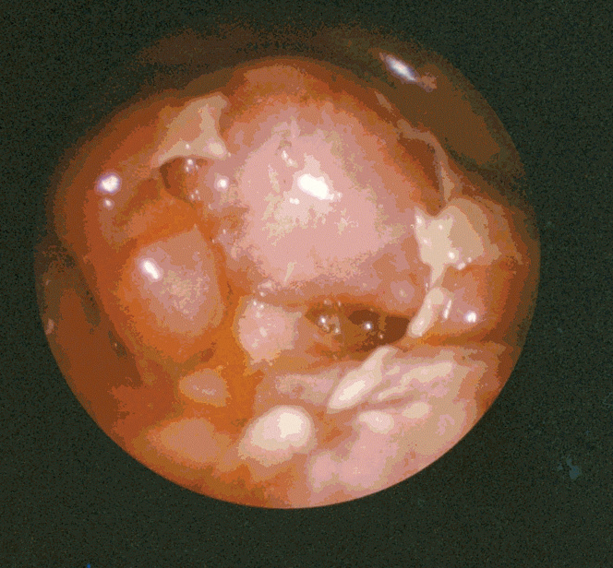
Laparoscopic confirmation of moderate acute salpingitis showing patchy fibrin deposits on the serosal surfaces of the fallopian tubes.

Slide 18
Management of PID
Mild to moderate symptoms and signs can manage as an OPD patient
Hospitalization needed
patients with clinically severe disease (severe illness, nausea and vomiting, or high fever),
those unable to follow or tolerate an outpatient oral regimen
pregnant women
women with a clinical diagnosis of tubo-ovarian abscess

Slide 19
Treatment of PID
Treatment consists of pelvic rest and antibiotics.
Antibiotic regimens
Empirical , broad-spectrum coverage of likely pathogens
N. gonorrhoeae
C. trachomatis
Anaerobes
Gram negative facultative bacteria
Streptococci

Slide 20
Treatment regiemns
Metronidazole should be prescribed for women with the clinical diagnosis of PID and concurrent BV
Fluoroquinolones alone are no longer recommended in the treatment of PID due to the emergence of quinolone-resistant N. gonorrhoeae.
Tests for gonorrhea must be performed before instituting therapy.
If the NAAT result is positive for gonorrhea, IV cephalosporin is recommended.
If culture for gonorrhea is positive, treatment should be based on results of ABST.

Slide 21
Treatment regiemns
Other outpatient regimens (mild to moderate )
If sexually acquired (multiple partners, STI inpartners)
Ceftriaxone 250mg IM single dose +
O. Doxycycline 100mg 12hrly for14 days +
Metranidazole 400mg 122hrly for 14 days.
Non sexually acquired
Amoxicillin /clavulanic acid + doxycycline + metranidazole- 14 days
or
CRO + Azithromycin + metronidazole
or
Co-amoxyclav + azithro+ Metranidazole

Slide 22
Treatment regiemns
If there is no response to therapy within 72 hours, patients should be re-evaluated and possibly hospitalized to confirm the diagnosis and for consideration of IV AB therapy if they are on an oral regimen.
All male sex partners of women with acute PID should be evaluated for STIs

Slide 23
Treatment regiemns
Severe PID
IV Co-amoxyclav + IV Ciprofloxacin + IV metranidazole
OR
IV Cefriaxone+ O. Doxy +IV metranidazole
Total duration 14 days
Switch to oral with clinical improvement

Slide 24
Management of Suspected Tubo-ovarian Abscess
suspect tubo-ovarian abscess
need hospitalization
broad-spectrum antimicrobial drugs that include adequate coverage
85% of abscesses with a diameter of 4 to 6 cm respond to antibiotics alone
Abscess size -10 cm or larger,only 40% of those respond to AB alone

Slide 25
Management of Suspected Tubo-ovarian Abscess cont..
Surgical intervention need if not respond to antimicrobial therapy
It can be performed laparoscopically, or by laparotomy.
A patient with a suspected leaking or ruptured abscess should undergo immediate surgical exploration after rapid stabilization and institution of broad spectrum of antibiotics.

Slide 26
Complications of PID
If diagnosed and treated early, the complications of PID can be prevented.
complications of PID
Formation of scar tissue both outside and inside the fallopian tubes that can lead to tubal obstruction
Ectopic pregnancy
Infertility
Chronic pelvic/abdominal pain
Dyspareunia

Slide 27
Questions ?

Slide 28
Thank You

